Slide 1

GROUP 1
Micron Technology, Inc.
As of April 17, 2026
RECOMMENDATION: BUY
Market Approach: $500.68 | DCF: $520.65 | Current: $448.42
A. Kelkelyan • B. Hasan • B. Soo • D. Yuan • D. Norona • G. Baek • N. Williams

Slide 2
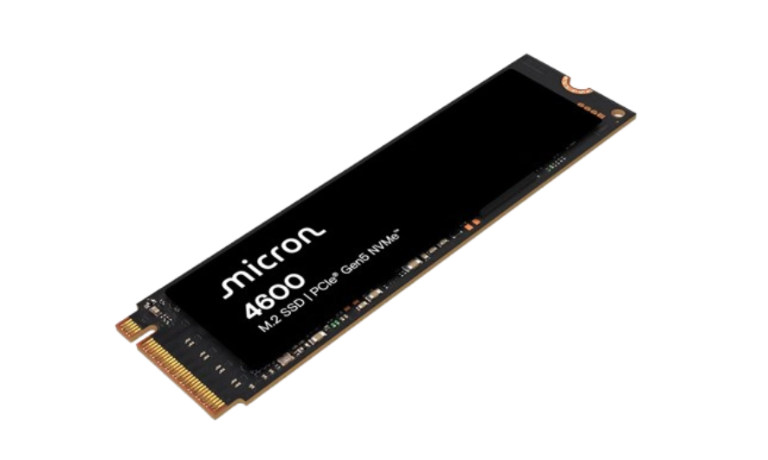
SECTION 01
Company Overview
One of three global scale producers of DRAM and a leading NAND supplier. HQ in Boise, Idaho
Design and manufacture storage and microchip solutions
Notable competitors include SK Hynix, Samsung, Western Digital, Intel Corp, Applied Materials Corp.
~$560BN
Market Cap
$448.42 Current Share Px
~530% 1Y Return

Slide 3
SECTION 01
Company Overview
Operations — Revenue Breakdown
CDBU
MCBU
CMBU
AEBU
Core Data Center Business Unit
Mobile & Client Business Unit
Cloud Memory Business Unit
Auto & Embedded Business Unit
$13,524M (36%)
$11,859M (32%)
$7,229M (19%)
$4,753M (13%)
FY25 revenue
FY25 revenue
FY25 revenue
FY25 revenue
Solutions for servers and traditional data center infrastructure outside of hyperscale
Storage for smartphones, PCs and other consumer products
Catered to hyperscalers and data center customers powering AI & cloud computing
Auto & industrial applications

Slide 4
SECTION 03
Data Collection & Methodology
PRIMARY
MARKET
REFERENCE
Company-filed
Quotes & multiples
Macro & cost-of-capital
Micron FY25 10-K
Bloomberg / Yahoo Finance
10Y Treasury — 4.20%
Most recent 10-Q
S&P Capital IQ
Equity risk premium — 2.50%
Earnings releases
Recent stock prices (4/17/26)
Equity beta — 1.77
Proxy statement
Peer financial data
Effective tax rate — 21%

Slide 5
SECTION 04
Economic & Industry Analysis
Porter's Five Forces
Macro Backdrop
Rivalry
Limited competitors but intense (Samsung, SK Hynix)
Consumers spend heavily on HBM
The semiconductor cycle is being driven by AI training, cloud computing, and data-center buildouts. Memory supply tightened through 2025 as hyperscalers absorbed HBM capacity. Macro risks remain:interest rates, capex sensitivity, and a cyclical industry that can swing on oversupply.
HIGH
New Entrants
$20B+ fab capex barrier, R&D intensity
Years of engineering required
LOW
Substitutes
Architectural alternatives, but no DRAM/NAND swap
MEDIUM
Micron's Competitive Position
Buyer Power
Concentrated hyperscaler customers
Customers buy huge quantities = Leverage
Micron is differentiated by accelerating HBM production, proprietary enterprise memory innovation, and over $45B in PP&E supported by CHIPS Act funding, reinforcing long-term manufacturing scale against Samsung and SK Hynix.
HIGH
Supplier Power
Limited material/tool suppliers (e.g., ASML)
Limits on sourcing flexibility
MEDIUM

Slide 6
SECTION 05
Comparative Analysis — Growth Rates
TOTAL REVENUE — YoY GROWTH
SEGMENT REVENUE GROWTH (Exercise 5 IS Projections)
+61.6%
Segment
FY24 YoY
FY25 YoY
FY26P YoY
+48.9%
CDBU (Cloud DC)
+103%
+257%
+75%
+11.0%
MCBU (Mobile)
+58%
+1.6%
+12%
FY22
FY24
FY25
CMBU (Compute)
+135%
+45%
+30%
-49.5%
AEBU (Auto/Emb.)
+12%
+2.6%
+15%
FY23

Slide 7
SECTION 06
Common-Size Analysis — FY21 vs. FY25
Income statement and balance sheet shown as percentages of revenue and total assets, respectively. FY21 (Year One) compared with FY25 (Year Five) to show how each line item progressed across the period.
INCOME STATEMENT (% of Revenue)
BALANCE SHEET (% of Total Assets)
Line item
FY21
FY25
Line item
FY21
FY25
Revenue
100.00%
100.00%
Total Cash & ST investments
14.67%
12.45%
Cost of goods sold
62.20%
60.21%
Total receivables
9.02%
11.19%
Gross profit
37.80%
39.79%
Inventory
7.62%
10.09%
SG&A
3.23%
3.22%
Net PP&E
33.83%
34.83%
R&D
9.61%
10.16%
Total current assets
57.37%
57.16%
Operating income
24.53%
26.24%
Total current liabilities
10.92%
13.83%
Net income
21.16%
22.84%
Long-term debt
10.15%
13.93%
Total liabilities
25.35%
34.58%
Total equity
74.65%
65.42%

Slide 8
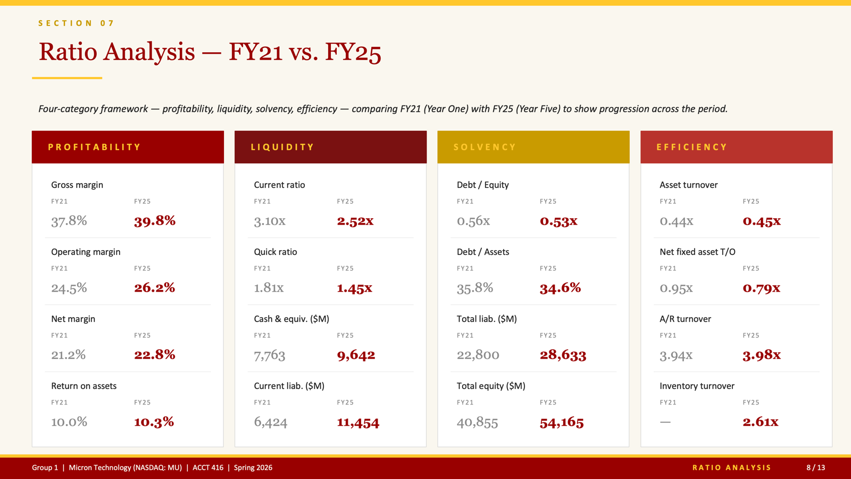
SECTION 07
Ratio Analysis — FY25
Four-category framework — profitability, liquidity, solvency, efficiency — using FY25 actual financials.
PROFITABILITY
LIQUIDITY
SOLVENCY
EFFICIENCY
Gross margin
Current ratio
Debt / Equity
Asset turnover
39.8%
2.52x
0.53x
0.45x
Operating margin
Quick ratio
Debt / Assets
Net fixed asset T/O
26.2%
1.45x
34.6%
0.79x
Net margin
Cash & equiv. ($M)
Total liab. ($M)
A/R turnover
22.8%
9,642
28,633
3.98x
Return on assets
Current liab. ($M)
Total equity ($M)
Inventory turnover
10.3%
11,454
54,165
2.61x
Source: Micron 10-K (FY25). Ratios computed in Exercise 3 spreadsheet.
RATIO ANALYSIS
8 / 13

Slide 9
SECTION 08
Peer Company Analysis
Three publicly traded comparables — Western Digital, Applied Materials, Intel — with multiples and operating ratios computed from each company's most recent annual filings
Company
Mkt Cap ($M)
EV/Revenue
EV/EBITDA
P/E
Net Debt/EBITDA
ROE
Micron (MU)
503,127
13.61x
28.13x
58.92x
0.32x
18.9%
Western Digital (WDC)
129,068
13.85x
53.30x
68.33x
1.11x
17.5%
Applied Materials (AMAT)
310,555
10.94x
34.69x
44.38x
(0.02x)
36.8%
Intel (INTC)
328,106
6.83x
28.57x
NMF
2.60x
0.0%
Peer Mean
—
10.54x
38.85x
56.35x
1.23x
18.1%
Peer Median
—
10.94x
34.69x
56.35x
1.11x
17.5%

Slide 10
SECTION 09
Five-Year Income Statement Forecast
$M
FY25A
FY26P
FY27P
FY28P
FY29P
FY30P
Revenue
37,378
51,813
73,989
94,262
109,721
117,398
Cost of goods sold
(22,505)
(29,533)
(42,914)
(64,098)
(65,833)
(64,569)
Gross profit
14,873
22,279
31,075
30,164
43,889
52,829
SG&A
(1,205)
(1,813)
(2,590)
(3,299)
(3,840)
(4,109)
R&D
(3,798)
(5,181)
(5,919)
(6,598)
(6,583)
(7,044)
Operating income
9,770
15,135
22,417
20,117
33,316
41,527
Net income
8,539
17,706
26,257
23,235
39,024
48,870

Slide 11
SECTION 10 • VALUATION
Market Approach
Approach
Selected Multiple
MU Metric ($M)
Implied Value ($M)
÷ Shares (M)
$/Share
Weight
P/E (peer mean)
58.75x
8,539 NI
501,638
1,122
$447.09
50%
EV/EBITDA (peer median)
34.69x
18,090 EBITDA
627,597
1,122
$554.27
50%
EV/Revenue (peer median)
10.94x
37,378 Rev
408,939
1,122
$359.38
0%
WEIGHTED MARKET APPROACH VALUE
Current: $448.42
$500.68
Upside: +11.7%
implied value per share

Slide 12
SECTION 11 • VALUATION
DCF — Income Approach
WACC build
Unlevered FCF ($M)
Risk-free rate (10Y UST)
4.20%
Item
FY26P
FY27P
FY28P
FY29P
FY30P
Equity risk premium
2.50%
EBIT
15,306
22,661
20,428
33,678
41,914
Levered beta
1.77
NOPAT (21%)
12,092
17,903
16,138
26,605
33,112
Cost of equity (CAPM)
8.63%
+ D&A
13,496
18,523
22,662
26,112
29,069
After-tax cost of debt
4.07%
– Capex
(24,352)
(26,424)
(21,761)
(18,134)
(15,544)
Equity weight
97.0%
– Δ NWC
(2,661)
(3,810)
(3,483)
(2,656)
(1,319)
UFCF
(1,425)
6,191
13,557
31,927
45,319
Debt weight
3.0%
WACC
8.52%
EV BRIDGE ($M)
DCF VALUE / SHARE
PV of FCF (Yrs 1–5)
$67,676
+ Net Cash
$5,710
$520.65
PV of Terminal Value
$512,349
Equity Value
$585,734
Enterprise Value
$580,025
÷ Shares (M)
1,125

Slide 13
SECTION 12 • FINAL RECOMMENDATION
Recommendation
VALUE PER SHARE
BUY
Market Approach
$500.68
+11.7%
DCF
$520.65
+16.1%
Current price
$448.42
Both valuation methods exceed the current market price.
Measurement date: 4/17/2026

